Slide 1

Cloud Web Services
Unit 5: AWS Networking
Version Code: CWS1
Released Date: 3-Dec-2018
1

Slide 2
AWS Networking
AIM:
To familiarise students about the networking services of AWS and VPC components, to provide the secure connection between AWS Cloud and On-Premise, configure Route53 for DNS and CloudFront for Content Delivery Network.
2

Slide 3
AWS Networking
Objective
The objectives of this module are to understand:
How to configure the instance level security.
How to configure the subnet level security.
Components of VPC to provide the secure connection between AWS and on premise.
Requirement of internet gateway for VPC.
Securing the instance by allowing the specific port and protocol.
Setting up dedicated hardware for VPC.
Secure the instances by making them part of private subnets.
Configure name resolution in AWS.
Access the data globally with less latency and increased performance.
3

Slide 4
AWS Networking
Outcome
The outcome of this module is to explain/ describe:
Securing the instance by assigning the security groups with required ports.
Securing the instance by configuring the ACLs on subnet level.
Components of VPC to provide the secure connection between AWS and On-premise.
Hardware components used to configure a VPN in customer gateway.
Securing the instance by allowing the specific port and protocol using Security groups.
Understanding the differences between dedicated host and dedicated instance.
Based on the level of accessibility we can put the instances either in private subnet or public
subnet.
Implementing Name resolution using AWS Route53 service.
CloudFront provides the greater performance with less latency to access the data globally.
10

Slide 5
AWS Networking
Content
Access Control List
Security Groups
VPN Connections
VPC Scenarios and Examples
Amazon Route53
CloudFront
10

Slide 6
AWS Networking
Introduction to AWS Networking
AWS networking products enable you to isolate your cloud infrastructure, scale your request handling capacity, and connect your physical network to your private virtual network.
AWS networking products work together to meet the needs of your application.
For example, Elastic Load Balancing works with Amazon Virtual Private Cloud (VPC) to provide robust networking and security features.
10

Slide 7
AWS Networking
AWS Networking Products
Service | Product Type | Description
Amazon CloudFront | Content Delivery Network (CDN) | Highly secure global CDN to get content to your viewers with low latency and high transfer speeds.
Amazon VPC | Virtual Private Cloud | Isolate cloud resources with your own private virtual network.
AWS Direct Connect | Dedicated Network Connections to AWS | Dedicated network connection between your network and your Amazon VPC.
Elastic Load Balancing | Load Balancing | Automatically distribute application traffic across multiple Amazon EC2 instances in the cloud.
Amazon Route 53 | Domain Name Service (DNS) | Highly available and scalable cloud DNS to connect user requests to your AWS resources.
10

Slide 8
AWS Networking
Access Control List
10

Slide 9
AWS Networking
ACL for S3 Bucket
Access Control Lists (ACLs) are one of the resource-based access policy options that you can use to manage access to your buckets and objects. We can use ACLs to grant basic read/write permissions to other AWS accounts. There are limits to managing permissions using ACLs.
For example, you can grant permissions only to other AWS accounts; you cannot grant permissions to users in your account.
10

Slide 10
AWS Networking
ACL for S3 Bucket
Amazon S3 supports resource-based policies and user policies to manage access to your Amazon S3 resources. Resource-based policies include bucket policies, bucket ACLs, and object ACLs.
Amazon S3 Access Control Lists (ACLs) enables you to manage access to buckets and objects. Each bucket and object has an ACL attached to it as a sub resource. It defines which AWS accounts or groups are granted access and the type of access. When a request is received against a resource, Amazon S3 checks the corresponding ACL to verify that the requester has the necessary access permissions.
10

Slide 11
AWS Networking
Network ACLs
A network access control list (ACL) is an optional layer of security for your VPC that acts as a firewall for controlling traffic in and out of one or more subnets. You might set up network ACLs with rules similar to your security groups in order to add an additional layer of security to your VPC.
Your VPC automatically comes with a modifiable default network ACL. By default, it allows all inbound and outbound IPv4 traffic and, if applicable, IPv6 traffic.
You can create a custom network ACL and associate it with a subnet. By default, each custom network ACL denies all inbound and outbound traffic until you add rules.
Each subnet in your VPC must be associated with a network ACL. If you do not explicitly associate a subnet with a network ACL, the subnet is automatically associated with the default network ACL.
You can associate a network ACL with multiple subnets;
however, a subnet can be associated with only one network ACL at a time.
A network ACL contains a numbered list of rules that we evaluate in order, starting with the lowest numbered rule, to determine whether traffic is allowed in or out of any subnet associated with the network ACL.
The highest number that you can use for a rule is 32766. We recommend that you start by creating rules in increments (for example, increments of 10 or 100) so that you can insert new rules where you need to later on.
A network ACL has separate inbound and outbound rules,
and each rule can either allow or deny traffic.
Network ACLs are stateless; responses to allowed inbound traffic are subject to the rules for outbound traffic (and vice versa).
11

Slide 12
AWS Networking
Default Network ACL for VPC
The following is an example default network ACL for a VPC that supports IPv4 and IPv6.
Inbound
Rule # | Type | Protocol | Port Range | Source | Allow/Deny
100 | All IPv4 traffic | All | All | 0.0.0.0/0 | ALLOW
101 | All IPv6 traffic | All | All | ::/0 | ALLOW
* | All traffic | All | All | 0.0.0.0/0 | DENY
* | All IPv6 traffic | All | All | ::/0 | DENY
Outbound
Rule # | Type | Protocol | Port Range | Destination | Allow/Deny
100 | All traffic | all | all | 0.0.0.0/0 | ALLOW
101 | All IPv6 traffic | all | all | ::/0 | ALLOW
* | All traffic | all | all | 0.0.0.0/0 | DENY
* | All IPv6 traffic | all | all | ::/0 | DENY

Slide 13
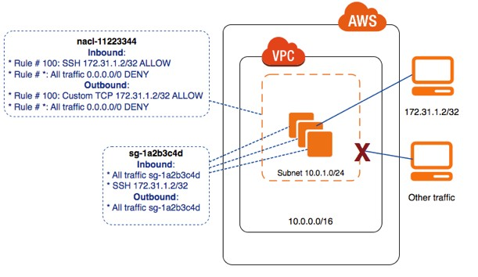
AWS Networking
Controlling Access to Instances in a Subnet
Your security group rules and network ACL rules allow access from the IP address of your remote computer (172.31.1.2/32). All other traffic from the Internet or other networks is denied.

Slide 14
AWS Networking
Security groups in AWS

Slide 15
AWS Networking
Characteristics of security groups
You have limits on the number of security groups that you can create per VPC, the number of rules that you can add to each security group, and the number of security groups you can associate with a network interface.
You can specify allow rules, but not deny rules.
You can specify separate rules for inbound and outbound traffic.
When you create a security group, it has no inbound rules.
By default, a security group includes an outbound rule that allows all outbound traffic. If your security group has no outbound rules, no outbound traffic originating from your instance is allowed.
Security groups are stateful — if you send a request from
your instance, the response traffic for that request is allowed to flow in regardless of inbound security group rules. Responses to allowed inbound traffic are allowed to flow out, regardless of outbound rules.
Instances associated with a security group cannot talk to each other unless you add rules allowing it (exception: the default security group has these rules by default).
Security groups are associated with network interfaces. After you launch an instance, you can change the security groups associated with the instance, which changes the security groups associated with the primary network interface (eth0).
When you create a security group, you must provide it
with a name and a description.
15

Slide 16
AWS Networking
Default rules for a default security group
Inbound
Source | Protocol | Port Range | Comments
The security group ID (sg-xxxxxxxx) | All | All | Allow inbound traffic from instances assigned to the same security group.
Outbound
Destination | Protocol | Port Range | Comments
0.0.0.0/0 | All | All | Allow all outbound IPv4 traffic.
::/0 | All | All | Allow all outbound IPv6 traffic. This rule is added by default if you create a VPC with an IPv6 CIDR block or if you associate an IPv6 CIDR block with your existing VPC.

Slide 17
AWS Networking
Rules for a security group for SSH,RDP, SQL and MySQL
Inbound
Source | Protocol | Port Range | Comments
Your network's public IPv4 address range | TCP | 22 | Allow inbound SSH access to Linux instances from IPv4 IP addresses in your network (over the Internet gateway)
Your network's public IPv4 address range | TCP | 3389 | Allow inbound RDP access to Windows instances from IPv4 IP addresses in your network (over the Internet gateway)
Outbound
Destination | Protocol | Port Range | Comments
The ID of the security group for your database servers | TCP | 1433 | Allow outbound Microsoft SQL Server access to instances in the specified security group
The ID of the security group for your MySQL database servers | TCP | 3306 | Allow outbound MySQL access to instances in the specified security group

Slide 18
AWS Networking
Security Group Rules
Stale Security Group Rules
If your VPC has a VPC peering connection with another VPC, a security group rule can reference another security group in the peer VPC. This allows instances associated with the referenced security group to communicate with instances associated with the referencing security group.
If the owner of the peer VPC deletes the referenced security group, or if you or the owner of the peer VPC deletes the VPC peering connection, the security group rule is marked as stale. You can delete stale security group rules as you would any other security group rule.

Slide 19
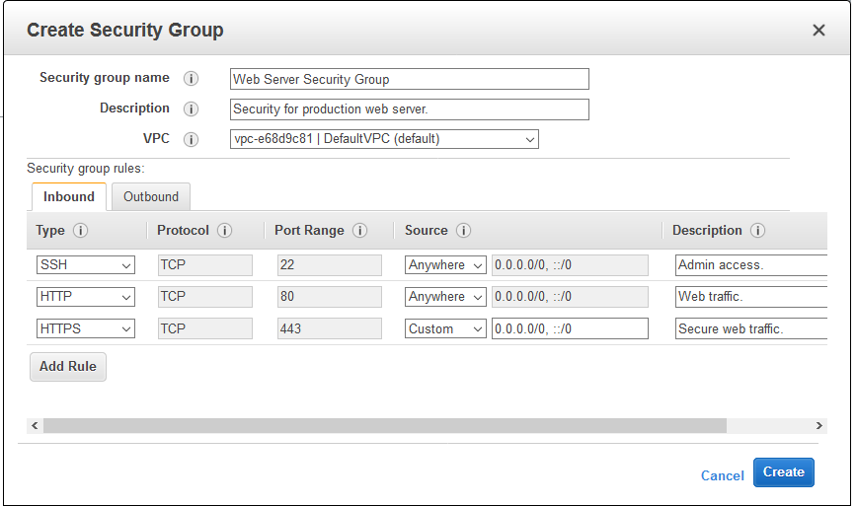
AWS Networking
Creating Security Group
You can add descriptive text to each of your
Security Group Rules.
This will simplify your operations and remove some opportunities for operator error.
Descriptions can be up to 255 characters long and can be set and viewed from the AWS Management Console, AWS Command Line Interface (CLI), and the AWS APIs.
You can enter a description when you create a new rule and you can edit descriptions for existing rules.

Slide 20
AWS Networking
VPN Connections

Slide 21
AWS Networking
VPN Connections
You can connect your Amazon VPC to remote networks by using a VPN connection. The following are
some of the connectivity options available to you.
VPN connectivity option | Description
AWS managed VPN | You can create an IPsec VPN connection between your VPC and your remote network. On the AWS side of the VPN connection, a virtual private gateway provides two VPN endpoints (tunnels) for automatic failover. You configure your customer gateway on the remote side of the VPN connection.
AWS VPN CloudHub | If you have more than one remote network (for example, multiple branch offices), you can create multiple AWS managed VPN connections via your virtual private gateway to enable communication between these networks.
Third party software VPN appliance | You can create a VPN connection to your remote network by using an Amazon EC2 instance in your VPC that's running a third party software VPN appliance. AWS does not provide or maintain third party software VPN appliances; however, you can choose from a range of products provided by partners and open source communities.

Slide 22
AWS Networking
Components of Your VPN
A VPN connection consists of the following components.
Virtual Private Gateway
A virtual private gateway is the VPN concentrator on the Amazon side of the VPN connection. You create a virtual private gateway and attach it to the VPC from which you want to create the VPN connection.
When you create a virtual private gateway, you can specify the private Autonomous System Number (ASN) for the Amazon side of the gateway. If you do not specify an ASN, the virtual private gateway is created with the default ASN (64512).
Customer Gateway
A customer gateway is a physical device or software application on your side of the VPN connection.
To create a VPN connection, you must create a customer gateway resource in AWS, which provides information to AWS about your customer gateway device.

Slide 23
AWS Networking
Customer Gateway
The following table describes the information required to create a customer gateway resource.
Item | Description
Internet-routable IP address (static) of the customer gateway's external interface. | The public IP address value must be static. If your customer gateway is behind a network address translation (NAT) device that's enabled for NAT traversal (NAT-T), use the public IP address of your NAT device, and adjust your firewall rules to unblock UDP port 4500.
(Dynamic routing only) Border Gateway Protocol (BGP) Autonomous System Number (ASN) of the customer gateway. | You can use an existing ASN assigned to your network. If you don't have one, you can use a private ASN (in the 64512–65534 range). If you use the VPC wizard in the console to set up your VPC, we automatically use 65000 as the ASN.

Slide 24
AWS Networking
AWS Managed VPN Categories
Your AWS managed VPN connection is either an AWS Classic VPN connection or an AWS VPN
connection.
Any new VPN connection that you create is an AWS VPN connection.
The following features are supported on AWS VPN connections only:
NAT traversal
4-byte ASN (in addition to 2-byte ASN)
CloudWatch metrics
Reusable IP addresses for your customer gateways
Additional encryption options; including AES 256-bit encryption, SHA-2 hashing, and additional Diffie-Hellman groups
Configurable tunnel options
Custom private ASN for the Amazon side of a BGP session

Slide 25
AWS Networking
To identify the VPN category using a command line tool
You can use the describe-VPN-connections AWS CLI command. In the output that is returned, take note
of the Category value. A value of VPN indicates an AWS VPN connection. A value of VPN-
Classic indicates an AWS Classic VPN connection.
In the following example, the VPN connection is an AWS VPN connection.
AWS EC2 describe-VPN-connections --VPN-connection-ids vpn-1a2b3c4d
{ "VpnConnections": [ { "VpnConnectionId": "vpn-1a2b3c4d", ... "State": "available", "VpnGatewayId": "vgw-11aa22bb", "CustomerGatewayId": "cgw-ab12cd34", "Type": "ipsec.1", "Category": "VPN" } ] }

Slide 26
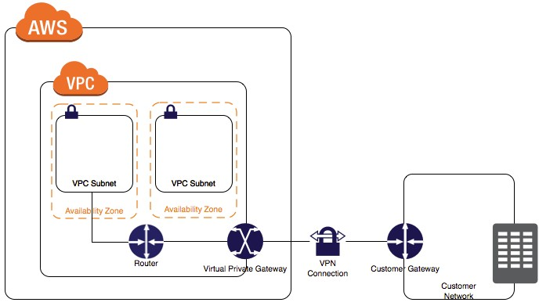
AWS Networking
VPN Configuration Example
The following diagrams illustrate single VPN connection. The VPC has an attached virtual private gateway, and your remote network includes a customer gateway, which you must configure to enable the VPN connection. You set up the routing so that any traffic from the VPC bound for your network is routed to the virtual private gateway.

Slide 27
AWS Networking
VPN Routing Options
When you create a VPN connection, you must do the following:
Specify the type of routing that you plan to use (static or dynamic).
Update the route table for your subnet.
There are limits on the number of routes that you can add to a route table.
Static and Dynamic Routing
The type of routing that you select can depend on the make and model of your VPN devices.
If your VPN device supports Border Gateway Protocol (BGP), specify dynamic routing when you
configure your VPN connection.
If your device does not support BGP, specify static routing.

Slide 28
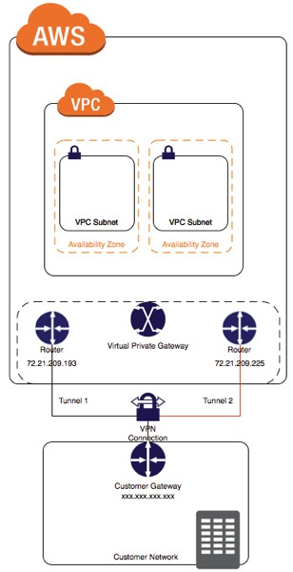
AWS Networking
Configuring the VPN Tunnels for Your VPN Connection
You use a VPN connection to connect your remote network to a VPC. Each VPN connection has two tunnels, with each tunnel using a unique virtual private gateway public IP address. It is important to configure both tunnels for redundancy.
The following diagram shows the two tunnels of the VPN
connection.

Slide 29
AWS Networking
VPC Scenarios and Examples

Slide 30
AWS Networking
Dedicated Hosts
An Amazon EC2 Dedicated Host is a physical server with EC2 instance capacity fully dedicated to your use.
Dedicated Hosts allow you to use your existing per-socket, per-core, or per-VM software licenses, including Windows Server, Microsoft SQL Server, SUSE, Linux Enterprise Server, and so on.

Slide 31
AWS Networking
Dedicated Instances
Dedicated Instances are Amazon EC2 instances that run in a Virtual Private Cloud (VPC) on hardware that is dedicated to a single customer.
Dedicated Instances that belong to different AWS accounts are physically isolated at the hardware
level.
In addition, Dedicated Instances that belong to AWS accounts that are linked to a single payer account
are also physically isolated at the hardware level.
However, Dedicated Instances may share hardware with other instances from the same AWS account that are not Dedicated Instances.
A Dedicated Host is also a physical server that is dedicated for your use. With a Dedicated Host, you
have visibility and control over how instances are placed on the server.

Slide 32
AWS Networking
Differences between Dedicated Hosts and Dedicated Instances
 | Dedicated Host | Dedicated Instance
Billing | Per-host billing | Per-instance billing
Visibility of sockets, cores, and host ID | Provides visibility of the number of sockets and physical cores. | No visibility
Host and instance affinity | Allows you to consistently deploy your instances to the same physical server over time. | Not supported
Targeted instance placement | Provides additional visibility and control over how instances are placed on a physical server. | Not supported
Automatic instance recovery | Not supported | Supported
Bring Your Own License (BYOL) | Supported | Not supported

Slide 33
AWS Networking
Dedicated Instance Basics
Each instance that you launch into a VPC has a tenancy attribute. This attribute has the following values.
Tenancy Value | Description
default | Your instance runs on shared hardware.
dedicated | Your instance runs on single-tenant hardware.
host | Your instance runs on a Dedicated Host, which is an isolated server with configurations that you can control.
Each VPC has a related instance tenancy attribute. This attribute has the following values.
Tenancy Value | Description
default | An instance launched into the VPC runs on shared hardware by default, unless you explicitly specify a different tenancy during instance launch.
dedicated | An instance launched into the VPC is a Dedicated Instance by default, unless you explicitly specify a tenancy of host during instance launch. You cannot specify a tenancy of default during instance launch.

Slide 34
AWS Networking
Creating a VPC with an Instance Tenancy of Dedicated
When you create a VPC, you have the option of specifying its instance tenancy. If you are using
the Amazon VPC console, you can create a VPC using the VPC wizard or the Your VPCs page.
To create a VPC with an instance tenancy of dedicated (VPC Wizard) follow the below steps:
Open the Amazon VPC console at https://console.aws.amazon.com/vpc/.
From the dashboard, choose Start VPC Wizard.
Select a VPC configuration, and then choose Select.
On the next page of the wizard, choose Dedicated from the Hardware tenancy list.
Choose Create VPC.

Slide 35
AWS Networking
Launching Dedicated Instances into a VPC
You can launch a Dedicated Instance using the Amazon EC2 launch instance wizard. To launch a Dedicated Instance into a default tenancy VPC using the console
Open the Amazon EC2 console at https://console.aws.amazon.com/ec2/.
Choose Launch Instance.
On the Choose an Amazon Machine Image (AMI) page, select an AMI and choose Select.
On the Choose an Instance Type page, select the instance type and choose Next: Configure
Instance Details.
Ensure that you choose an instance type that is supported as a Dedicated Instance.
On the Configure Instance Details page, select a VPC and subnet. Choose Dedicated - Run a
dedicated instance from the Tenancy list, and then Next: Add Storage.
Continue as prompted by the wizard. When you have finished reviewing your options on
the Review Instance Launch page, choose Launch to choose a key pair and launch the Dedicated Instance.
35

Slide 36
AWS Networking
Setting Up Dedicated Hardware For VPC
A hardware VPN connection connects your VPC to your datacentre. Amazon supports Internet Protocol security (IPsec) VPN connections. Data transferred between your VPC and datacentre routes over an encrypted VPN connection to help maintain the confidentiality and integrity of data in transit. An Internet gateway is not required to establish a hardware VPN connection.
What are the customer gateway devices are known to
work with Amazon VPC ?
The following devices meeting the aforementioned requirements are known to work with hardware VPN connections, and have support in the command line tools for automatic generation of configuration files appropriate for your device:
Statically-routed VPN connections
Cisco ASA 5500 Series version 8.2 (or later)
software
Cisco ISR running Cisco IOS 12.4 (or later)
software
Cisco Meraki MX Series iOS 9.0 (or later) software
Dynamically-routed VPN connections (requires BGP)
Barracuda NextGen Firewall F-Series running 6.2 (or later) software
Check Point Security Gateway running R77.10 (or later) software
Cisco ISR running Cisco IOS 12.4 (or later)
software

Slide 37
AWS Networking
VPC Scenarios and Examples
This section has examples for creating and configuring a VPC, including scenarios for how to use the
VPC wizard in the Amazon VPC console.
Scenario | Usage
Scenario 1: VPC with a Single Public Subnet | Use the VPC wizard to create a VPC for running a single-tier, public-facing web application such as a blog or simple web site.
Scenario 2: VPC with Public and Private Subnets (NAT) | Use the VPC wizard to create a VPC for running a public-facing web application, while still maintaining non-publicly accessible back-end servers in a second subnet.
Scenario 3: VPC with Public and Private Subnets and AWS Managed VPN Access | Use the VPC wizard to create a VPC for extending your data centre into the cloud, and also directly access the Internet from your VPC.
Scenario 4: VPC with a Private Subnet Only and AWS Managed VPN Access | Use the VPC wizard to create a VPC for extending your data centre into the cloud, and leverage Amazon's infrastructure without exposing your network to the Internet.

Slide 38
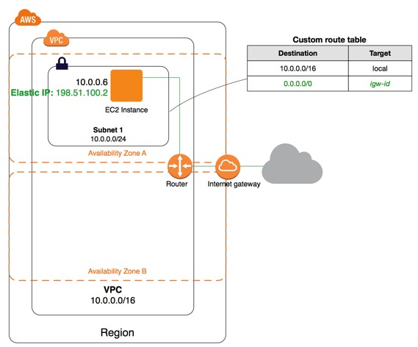
AWS Networking
Scenario 1: VPC with a Single Public Subnet
The configuration for this scenario includes a Virtual Private Cloud (VPC) with a single public subnet, and an Internet gateway to enable communication over the Internet. We recommend this configuration if you need to run a single-tier, public-facing web application, such as a blog or a simple website.
The following diagram shows the key components of the configuration for this scenario.

Slide 39
AWS Networking
Scenario 1: VPC with a Single Public Subnet
The configuration for this scenario includes the following:
A Virtual Private Cloud (VPC) with a size /16 IPv4 CIDR block (example: 10.0.0.0/16). This
provides 65,536 private IPv4 addresses.
A subnet with a size /24 IPv4 CIDR block (example: 10.0.0.0/24). This provides 256 private IPv4 addresses.
An Internet gateway. This connects the VPC to the Internet and to other AWS services.
An instance with a private IPv4 address in the subnet range (example: 10.0.0.6), which enables the instance to communicate with other instances in the VPC, and an Elastic IPv4 address (example: 198.51.100.2), which is a public IPv4 address that enables the instance to be reached from the Internet.
A custom route table associated with the subnet. The route table entries enable instances in the subnet to use IPv4 to communicate with other instances in the VPC, and to communicate directly over the Internet. A subnet that's associated with a route table that has a route to an Internet gateway is known as a public subnet.

Slide 40
AWS Networking
Scenario 2: VPC with Public and Private Subnets (NAT)
The configuration for this scenario includes a Virtual Private Cloud (VPC) with a public subnet and a private subnet. We recommend this scenario if you want to run a public-facing web application, while maintaining back-end servers that are not publicly accessible.
A common example is a multi-tier website, with the web servers in a public subnet and the database servers in a private subnet.
You can set up security and routing so that the web servers can communicate with the database servers.
The instances in the public subnet can send outbound traffic directly to the Internet, whereas the instances in the private subnet cannot. Instead, the instances in the private subnet can access the Internet by using a Network Address Translation (NAT) gateway that resides in the public subnet.
The database servers can connect to the Internet for software updates using the NAT gateway, but the Internet cannot establish connections to the database servers.

Slide 41
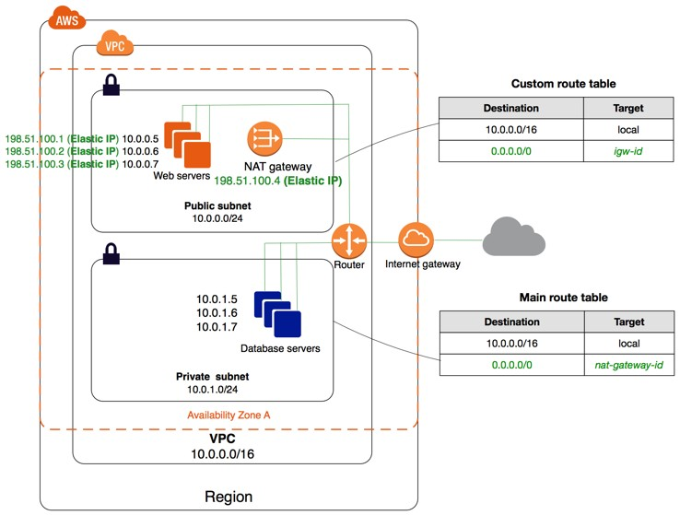
AWS Networking
Scenario 2: VPC with Public and Private Subnets (NAT)
The following diagram shows the key components of the configuration for this scenario.

Slide 42
AWS Networking
Scenario 2: VPC with Public and Private Subnets (NAT)
The configuration for this scenario includes the following:
A VPC with a size /16 IPv4 CIDR block (example: 10.0.0.0/16). This provides 65,536 private IPv4
addresses.
A public subnet with a size /24 IPv4 CIDR block (example: 10.0.0.0/24). This provides 256 private IPv4 addresses. A public subnet is a subnet that is associated with a route table that has a route to an Internet gateway.
A private subnet with a size /24 IPv4 CIDR block (example: 10.0.1.0/24). This provides 256 private
IPv4 addresses.
An Internet gateway. This connects the VPC to the Internet and to other AWS services.
Instances with private IPv4 addresses in the subnet range (examples: 10.0.0.5, 10.0.1.5). This enables them to communicate with each other and other instances in the VPC.
Instances in the public subnet with Elastic IPv4 addresses (example: 198.51.100.1), which are public IPv4 addresses that enable them to be reached from the Internet.

Slide 43
AWS Networking
Scenario 2: VPC with Public and Private Subnets (NAT)
The instances can have public IP addresses assigned at launch instead of Elastic IP addresses. Instances in the private subnet are back-end servers that do not need to accept incoming traffic from the Internet and therefore do not have public IP addresses; however, they can send requests to the Internet using the NAT gateway.
A NAT gateway with its own Elastic IPv4 address. Instances in the private subnet can send requests to the Internet through the NAT gateway over IPv4 (for example, for software updates).
A custom route table associated with the public subnet. This route table contains an entry that enables instances in the subnet to communicate with other instances in the VPC over IPv4, and an entry that enables instances in the subnet to communicate directly with the Internet over IPv4.
The main route table associated with the private subnet. The route table contains an entry that enables instances in the subnet to communicate with other instances in the VPC over IPv4, and an entry that enables instances in the subnet to communicate with the Internet through the NAT gateway over IPv4.

Slide 44
AWS Networking
Scenario 3: VPC with Public and Private Subnets and AWS Managed VPN Access
The configuration for this scenario includes a Virtual Private Cloud (VPC) with a public subnet and a private subnet, and a virtual private gateway to enable communication with your own network over an IPsec VPN tunnel.
We recommend this scenario if you want to extend your network into the cloud and also directly access the Internet from your VPC.
This scenario enables you to run a multi-tiered application with a scalable web front end in a public subnet, and to house your data in a private subnet that is connected to your network by an IPsec VPN connection.

Slide 45
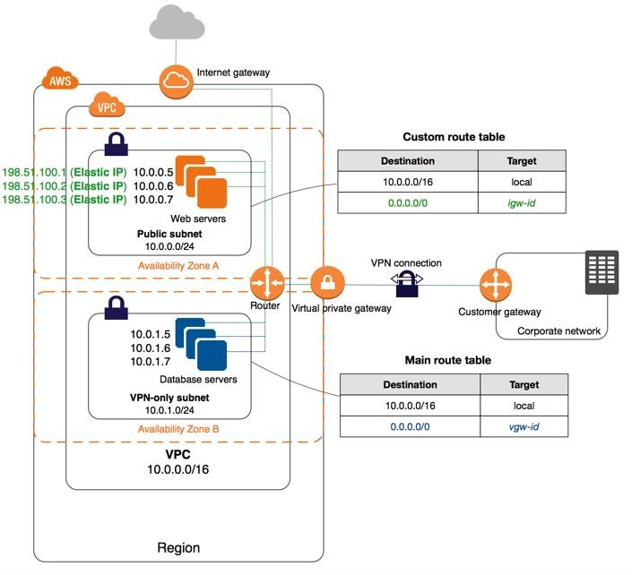
AWS Networking
Scenario 3: VPC with Public and Private Subnets and AWS Managed VPN Access
The following diagram shows the key components of the configuration for this scenario.

Slide 46
AWS Networking
Scenario 3: VPC with Public and Private Subnets and AWS Managed VPN Access
The configuration for this scenario includes the following:
A Virtual Private Cloud (VPC) with a size /16 IPv4 CIDR (example: 10.0.0.0/16). This
provides 65,536 private IPv4 addresses.
A public subnet with a size /24 IPv4 CIDR (example: 10.0.0.0/24). This provides 256 private IPv4 addresses. A public subnet is a subnet that is associated with a route table that has a route to an Internet gateway.
A VPN-only subnet with a size /24 IPv4 CIDR (example: 10.0.1.0/24). This provides 256
private IPv4 addresses.
An Internet gateway. This connects the VPC to the Internet and to other AWS products.
A VPN connection between your VPC and your network. The VPN connection consists of a virtual private gateway located on the Amazon side of the VPN connection and a customer gateway located on your side of the VPN connection.

Slide 47
AWS Networking
Scenario 3: VPC with Public and Private Subnets and AWS Managed VPN Access
Instances with private IPv4 addresses in the subnet range (examples: 10.0.0.5 and 10.0.1.5), which enables the instances to communicate with each other and other instances in the VPC.
Instances in the public subnet with Elastic IP addresses (example: 198.51.100.1), which are public IPv4 addresses that enable them to reach from the Internet. The instances can have public IPv4 addresses assigned at launch instead of Elastic IP addresses. Instances in the VPN-only subnet are
back-end servers that do not need to accept incoming traffic from the Internet, but can send and receive
traffic from your network.
A custom route table associated with the public subnet. This route table contains an entry that enables instances in the subnet to communicate with other instances in the VPC, and an entry that enables instances in the subnet to communicate directly with the Internet.
The main route table associated with the VPN-only subnet. The route table contains an entry that enables instances in the subnet to communicate with other instances in the VPC, and an entry that enables instances in the subnet to communicate directly with your network.

Slide 48
AWS Networking
Scenario 3: VPC with Public and Private Subnets and AWS Managed VPN Access
The configuration for this scenario includes a Virtual Private Cloud (VPC) with a single private subnet, and a virtual private gateway to enable communication with your own network over an IPsec VPN tunnel.
There is no Internet gateway to enable communication over the Internet.
We recommend this scenario if you want to extend your network into the cloud using Amazon's
infrastructure without exposing your network to the Internet.

Slide 49
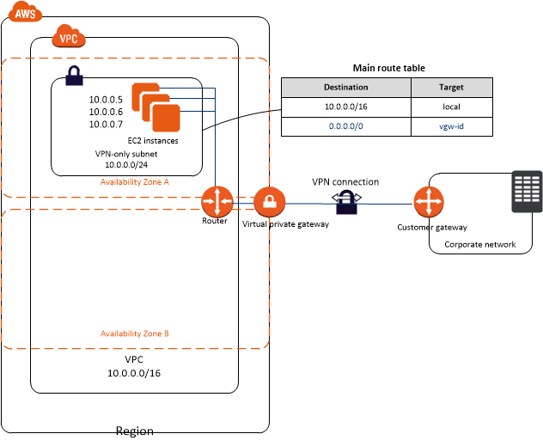
AWS Networking
Scenario 4: VPC with a Private Subnet Only and AWS Managed VPN Access
The following diagram shows the key components of the configuration for this scenario.

Slide 50
AWS Networking
Scenario 4: VPC with a Private Subnet Only and AWS Managed VPN Access
The configuration for this scenario includes the following:
A Virtual Private Cloud (VPC) with a size /16 CIDR (example: 10.0.0.0/16). This provides 65,536
private IP addresses.
A VPN-only subnet with a size /24 CIDR (example: 10.0.0.0/24). This provides 256 private IP addresses.
A VPN connection between your VPC and your network. The VPN connection consists of a virtual private gateway located on the Amazon side of the VPN connection and a customer gateway located on your side of the VPN connection.
Instances with private IP addresses in the subnet range (examples: 10.0.0.5, 10.0.0.6, and 10.0.0.7), which enables the instances to communicate with each other and other instances in the VPC.
The main route table contains a route that enables instances in the subnet to communicate with other instances in the VPC. Route propagation is enabled, so a route that enables instances in the subnet to communicate directly with your network appears as a propagated route in the main route table.

Slide 51
AWS Networking
Amazon Route 53

Slide 52
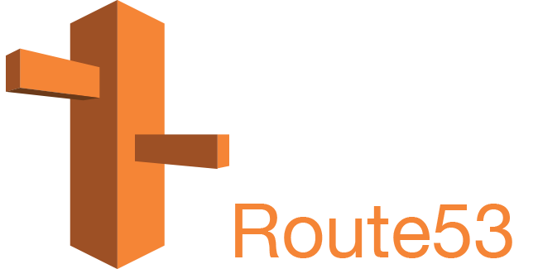
AWS Networking
Amazon Route 53
Amazon Route 53 is a highly available and scalable cloud Domain Name System (DNS) web service.
It is designed to give developers and businesses an extremely reliable and cost effective way to route end users to Internet applications by translating names like www.example.com into the numeric IP addresses like 192.0.2.1 that computers use to connect to each other.
Amazon Route 53 is fully compliant with IPv6 as well.
Amazon Route 53 effectively connects user requests to infrastructure running in AWS – such as Amazon EC2 instances, Elastic Load Balancing load balancers, or Amazon S3 buckets – and can also be used to route users to infrastructure outside of AWS.

Slide 53
AWS Networking
What is Amazon Route 53?
Amazon Route 53 is a highly available and scalable Domain Name System (DNS) web service. You can use Route 53 to perform three main functions in any combination: domain registration, DNS routing, and health checking. If you choose to use Route 53 for all three functions, perform the steps in this order:
Register domain names : Your website needs a name, such as example.com. Route 53 lets you register a name for your website or web application, known as a domain name.
Route internet traffic to the resources for your domain :When a user opens a web browser and enters your domain name (example.com) or subdomain name (apex.example.com) in the address bar, Route 53 helps connect the browser with your website or web application.
Check the health of your resources : Route 53 sends automated requests over the internet to a resource, such as a web server, to verify that it is reachable, available, and functional. You also can choose to receive notifications when a resource becomes unavailable and choose to route internet traffic away from unhealthy resources.

Slide 54
AWS Networking
Domain Registration Concepts
Domain name : The name, such as example.com, that a user types in the address bar of a web browser to access a website or a web application.
Domain registrar : A company that is accredited by ICANN (Internet Corporation for Assigned Names and Numbers) to process domain registrations for specific top-level domains (TLDs). For example, Amazon Registrar, Inc. is a domain registrar for .com, .net, and .org domains.
Domain registry : A company that owns the right to sell domains that have a specific top-level domain.
For example, VeriSign is the registry that owns the right to sell domains that have a .com TLD.
Domain reseller : A company that sells domain names for registrars such as Amazon Registrar. Amazon Route 53 is a domain reseller for Amazon Registrar
Top-level domain (TLD) : The last part of a domain name, such as .com, .org, or .ninja. There are two types of top-level domains:
Generic top-level domains : These TLDs typically give users an idea of what they will find on the website.
Geographic top-level domains : These TLDs are associated with geographic areas such as countries or cities.

Slide 55
AWS Networking
Domain Name System (DNS) Concepts
Alias record : A type of record that you can create with Amazon Route 53 to route traffic to AWS resources
such as Amazon CloudFront distributions and Amazon S3 buckets.
Authoritative name server : A name server that has definitive information about one part of the Domain Name System (DNS) and that responds to requests from a DNS resolver by returning the applicable information.
DNS query : Usually a request that is submitted by a device, such as a computer or a smart phone, to the
Domain Name System (DNS) for a resource that is associated with a domain name.
DNS resolver : A DNS server, often managed by an Internet Service Provider (ISP), that acts as an intermediary between user requests and DNS name servers.
Domain Name System (DNS) : A worldwide network of servers that help computers, smart phones, tablets,
and other IP-enabled devices to communicate with one another.
Hosted zone : A container for records, which includes information about how you want to route traffic for a domain (such as example.com) and all of its subdomains (such as www.example.com, retail.example.com, and seattle.accounting.example.com). A hosted zone has the same name as the corresponding domain.

Slide 56
AWS Networking
Domain Name System (DNS) Concepts
IP address : A number that is assigned to a device on the internet—such as a laptop, a smart phone, or a web server—that allows the device to communicate with other devices on the internet.
Internet Protocol version 4 (IPv4) format, such as 192.0.2.44
Internet Protocol version 6 (IPv6) format, such as 2001:0db8:85a3:0000:0000:abcd:0001:2345
Name servers: Servers in the Domain Name System (DNS) that help to translate domain names into the IP addresses that computers use to communicate with one another. Name servers are either recursive name servers (also known as DNS resolver) or authoritative name servers.
Private DNS : A local version of the Domain Name System (DNS) that lets you route traffic for a domain and its subdomains to Amazon EC2 instances within one or more Amazon Virtual Private Clouds (VPCs).
Record (DNS record) : An object in a hosted zone that you use to define how you want to route traffic for the domain or a subdomain. For example, you might create records for example.com and www.example.com that route traffic to a web server that has an IP address of 192.0.2.234.
56

Slide 57
AWS Networking
Domain Name System (DNS) Concepts
Reusable delegation set : A set of four authoritative name servers that you can use with more than one hosted zone. By default, Route 53 assigns a random selection of name servers to each new hosted zone.
Subdomain : A domain name that has one or more labels prepended to the registered domain name. For example, if you register the domain name example.com, then www.example.com is a subdomain. If you create the hosted zone accounting.example.com for the example.com domain, then seattle.accounting.example.com is a subdomain.
Time to live (TTL) : The amount of time, in seconds, that you want a DNS resolver to cache (store) the values for a record before submitting another request to Route 53 to get the current values for that record.

Slide 58
AWS Networking
Domain Name System (DNS) Concepts
Routing policy : A setting for records that determines how Route 53 responds to DNS queries. Route 53 supports the following routing policies:
Simple routing policy – Use to route internet traffic to a single resource that performs a given
function for your domain, for example, a web server that serves content for the example.com website.
Failover routing policy – Use when you want to configure active-passive failover.
Geolocation routing policy – Use when you want to route internet traffic to your resources based on the location of your users.
Geoproximity routing policy – Use when you want to route traffic based on the location of your
resources and, optionally, shift traffic from resources in one location to resources in another.
Latency routing policy – Use when you have resources in multiple locations and you want to route
traffic to the resource that provides the best latency.
Multivalue answer routing policy – Use when you want Route 53 to respond to DNS queries with
up to eight healthy records selected at random.
Weighted routing policy – Use to route traffic to multiple resources in proportions that you specify.

Slide 59
AWS Networking
Health Checking Concepts
DNS failover : A method for routing traffic away from unhealthy resources and to healthy resources.
Endpoint : The resource, such as a web server or an email server, that you configure a health check to
monitor the health of.
You can specify an endpoint by IPv4 address (192.0.2.243), by IPv6 address
(2001:0db8:85a3:0000:0000:abcd:0001:2345), or by domain name (example.com).
health check : A Route 53 component that lets you do the following:
Monitor whether a specified endpoint, such as a web server, is healthy
Optionally, get notified when an endpoint becomes unhealthy
Optionally, configure DNS failover, which allows you to reroute internet traffic from an
unhealthy resource to a healthy resource

Slide 60
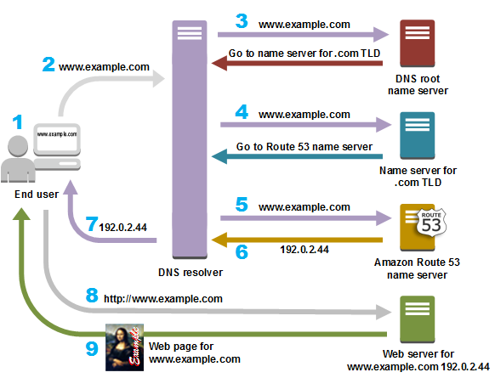
AWS Networking
How Does DNS Route Traffic To Your Web Application?

Slide 61
AWS Networking
CloudFront

Slide 62
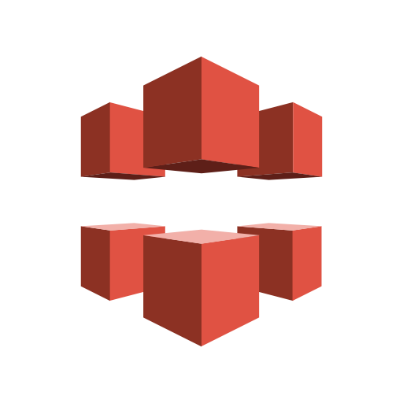
AWS Networking
What is an Amazon CloudFront ?
Amazon CloudFront is a fast Content Delivery Network (CDN) service that securely delivers data, videos, applications, and APIs to customers globally with low latency, high transfer speeds, all within a developer-friendly environment.
CloudFront is integrated with AWS – both physical locations that are directly connected to the AWS global infrastructure, as well as other AWS services.
CloudFront works seamlessly with services including AWS Shield for DDoS mitigation, Amazon S3, Elastic Load Balancing or Amazon EC2 as origins for your applications, and Lambda@Edge to run custom code closer to customers’ users and to customize the user experience.

Slide 63
AWS Networking
What is a CDN?
A CDN, or Content Delivery Network, is a group of servers strategically placed across the globe with the purpose of delivering static content to users much faster.
When a visitor makes a request to a website, that request is routed to the nearest possible CDN edge
server, thus reducing latency and improving site speed.
Here is an example of just some of the file types that can be hosted on a CDN:
Images: PNG, JPG, SVG, GIF, TIF
Stylesheets: CSS
Javascript: JS
Video and Audio: FLV (Flash), HLS, MP4 (HTML5 videos), MOV (QuickTime), WMV
(Windows Media), MP3 and WAV
Web Fonts: EOT, TTF, OTF, CFF, AFM, LWFN, FFIL, FON, PFM, PFB, WOFF, SVG, STD,
PRO, XSF, and more…
Other File Formats: HTML, JSON, PDF, DOC, PPT, XLS, EPUB, ODT, ODP, ODS, TXT, RTF, ZIP
63

Slide 64
AWS Networking
Benefits of CloudFront
Fast and global
The Amazon CloudFront Content Delivery Network (CDN) is massively scaled and globally distributed.
The CloudFront network has 138 Points of Presence (PoPs), and leverages the highly-resilient Amazon backbone
network for superior performance and availability for your end users.
Security at the edge
Amazon CloudFront is a highly-secure CDN that provides both network and application level protection.
Highly programmable
Amazon CloudFront features can be customised for your specific application requirements.
The CDN also supports integrations with other tools and automation interfaces for today's DevOps and CI/CD environments by using native APIs or AWS tools.
Deep integration with AWS
Amazon CloudFront is integrated with AWS services such as Amazon S3, Amazon EC2, Elastic Load Balancing,
Amazon Route 53, and AWS Elemental Media Services.

Slide 65
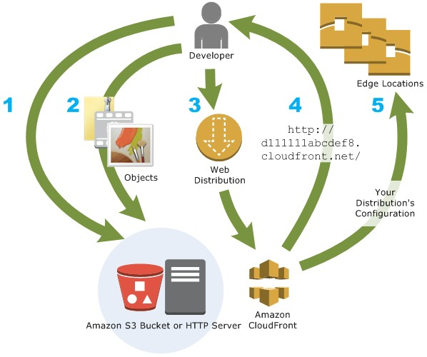
AWS Networking
How You Set Up CloudFront to Deliver Content
You create a CloudFront distribution to tell CloudFront where you want content to be delivered from, and the details about how to track and manage content delivery.
Then CloudFront uses computers—edge servers—that are close to your viewers to deliver that content quickly when someone wants to see it or use it.
You specify origin servers.
You upload your files to your origin servers.
You create a CloudFront distribution.
CloudFront assigns a domain name to your
new distribution.
CloudFront sends your distribution's
configuration to all of its edge locations.

Slide 66
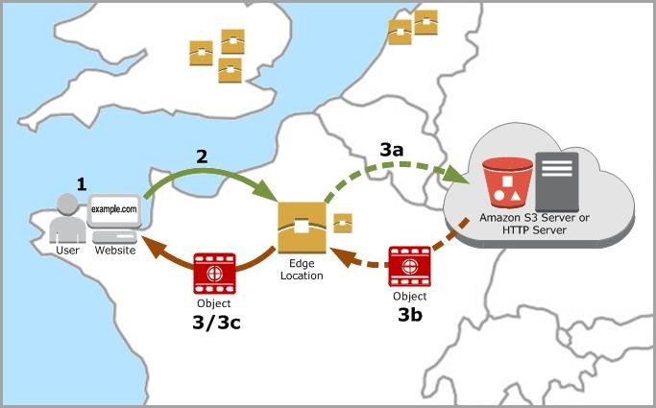
AWS Networking
How CloudFront Delivers Content to Your Users
A user accesses your website or application and requests one or more objects, such as an image file and an HTML file.
DNS routes the request to the CloudFront edge location that can best serve the request.
In the edge location, CloudFront checks its cache for the requested files. If the files are in the cache, CloudFront returns them to the user. If the files are not in the cache, it does the following:
CloudFront compares the request with the specifications in your distribution and forwards the request for the files to the applicable origin server for the corresponding file .
The origin servers send the files back to the CloudFront edge location.
As soon as the first byte arrives from the origin, CloudFront begins to forward the files to the user. CloudFront also adds the files to the cache in the edge location for the next time someone requests those files.
66

Slide 67
AWS Networking
Self Assessment Questions
67

Slide 68
AWS Networking
Self Assessment Questions
Which one of the given statement is not true for a network Access Control List (ACL) ?
Your VPC automatically comes with a modifiable default network ACL. By default, it allows
all inbound and outbound IPv4 traffic and, if applicable, IPv6 traffic.
You can create a custom network ACL and associate it with a subnet. By default, each custom network ACL denies all inbound and outbound traffic until you add rules.
You can associate a network ACL only with single subnet.
Each subnet in your VPC must be associated with a network ACL.
Answer: You can associate a network ACL only with single subnet.
68

Slide 69
AWS Networking
Self Assessment Questions
An internet gateway is a horizontally scaled, redundant, and highly available VPC component that allows communication between .
Instances of same subnet
Subnets of same VPC
Instances in your VPC and the another VPC
Instances in your VPC and the internet.
Answer: Instances in your VPC and the internet.

Slide 70
AWS Networking
Self Assessment Questions
3. For IPv4 address the VPC and Subnet CIDR block size can be from .
a. /8 to /32
b. /16 to /30
c. /16 to /28
d. /16 to /29
Answer: /16 to /28

Slide 71
AWS Networking
Self Assessment Questions
4. Which one of the given statement is not true about Security Group?
A security group acts as a virtual firewall that controls the traffic for one or more instances.
When you launch an instance, you associate one or more security groups with the instance.
You add rules to each security group that allow traffic to or from its associated instances.
You can deny the port 80 for a instance using security group.
Answer: You can deny the port 80 for a instance using security group.

Slide 72
AWS Networking
Self Assessment Questions
Which one of the given options is used to connect Amazon VPC to remote networks by using a
VPN connection?
AWS managed VPN
AWS VPN CloudHub
Third party software VPN appliance
Only i
Only ii
Only i and ii
All i, ii and iii
Answer: All i, ii and iii
72

Slide 73
AWS Networking
Self Assessment Questions
6. Which statement is true for Virtual Private Gateway?
A virtual private gateway is the VPN concentrator on the Amazon side of the VPN connection.
You create a virtual private gateway and attach it to the VPC from which you want to create the VPN connection.
When you create a virtual private gateway, you can specify the private Autonomous System Number (ASN) for the Amazon side of the gateway.
iv. If you don't specify an ASN, the virtual private gateway is created with the default ASN
(64510).
iii.
(i) , (ii) and (iv) are Correct
(i) , (ii) and (iii )are Correct
Both (iii) and (iv)
Only (iv) is correct
Answer: (i) , (ii) and (iii )are Correct
73

Slide 74
AWS Networking
Self Assessment Questions
Which one of the given statement is true for Customer Gateway?
A customer gateway is a physical device.
A customer gateway is a software application on your side of the VPN connection.
To create a VPN connection, you must create a customer gateway resource in AWS, which provides information to AWS about your customer gateway device.
Only i
Only ii
Only i and ii
All i, ii and iii
Answer: All i, ii and iii

Slide 75
AWS Networking
Self Assessment Questions
8. Which one of the given statement is not true for Dedicated Host and Dedicated Instance?
Dedicated Host Provides visibility of the number of sockets and physical cores.
Automatic instance recovery is supported by Dedicated Host.
Bring Your Own License (BYOL) is not supported by Dedicated instance.
Host and instance affinity is not supported by Dedicated instance.
Answer: Automatic instance recovery is supported by Dedicated Host.

Slide 76
AWS Networking
Self Assessment Questions
In which scenario we need a NAT Gateway or NAT instance to access public network for the
instance?
Scenario 1: VPC with a Single Public Subnet
Scenario 2: VPC with Public and Private Subnets
Scenario 3: VPC with Public and Private Subnets and AWS Managed VPN Access
Scenario 4: VPC with a Private Subnet Only and AWS Managed VPN Access
Answer: Scenario 2: VPC with Public and Private Subnets

Slide 77
AWS Networking
Self Assessment Questions
10. Which one of the given VPN connectivity operates on a simple hub-and-spoke model that you
can use with or without a VPC?
AWS managed VPN
AWS VPN CloudHub
Third party software VPN appliance
Answer: AWS VPN CloudHub

Slide 78
AWS Networking
Self Assessment Questions
11. How do I determine which Availability Zone my subnets are located in?
When you create a subnet you must specify the Availability Zone in which to place the subnet.
When using the VPC Wizard, you can select the subnet's Availability Zone in the wizard
confirmation screen.
If you don’t specify an Availability Zone, the default "No Preference" option will be selected
and the subnet will be created in an available Availability Zone in the region.
All of the above
Answer: All of the above
78

Slide 79
AWS Networking
Self Assessment Questions
Am I charged for network bandwidth between instances in different subnets?
If the instances reside in subnets in same Availability Zones, you will be charged $0.01 per GB for data transfer.
If the instances reside in subnets in different Availability Zones, you will be charged $0.01
per GB for data transfer.
Network bandwidth Charges are applicable for the instances of different availability zones.
Network bandwidth Charges are not applicable for the instances of same availability zones.
Answer: If the instances reside in subnets in different Availability Zones, you will be
charged $0.01 per GB for data transfer.

Slide 80
AWS Networking
Self Assessment Questions
13. Can I peer my VPC with a VPC belonging to another AWS account?
Yes
No
Answer: Yes

Slide 81
AWS Networking
Self Assessment Questions
What is the approximate maximum throughput of a VPN connection?
VGW supports IPSEC VPN throughput upto 1.25 Gbps.
Multiple VPN connections to the same VPC are cumulatively bound by the VGW throughput of 2.50 Gbps.
VGW supports IPSEC VPN throughput upto 2.50 Gbps.
VGW supports IPSEC VPN throughput more than 2.50 Gbps.
Answer: VGW supports IPSEC VPN throughput upto 1.25 Gbps.

Slide 82
AWS Networking
Self Assessment Questions
15. Which DNS record types does Amazon Route 53 support?
SOA (start of authority record)
SPF (sender policy framework)
SRV (service locator)
All of the above
Answer: All of the above

Slide 83
AWS Networking
Assignment
Prepare a document which differentiates between ACL and Security Groups.
Create VPC with multiple subnets and check for the communication between the instances which are
part of different subnets.
Configure the NAT Gateway/NAT instance for the instance which are part of private subnet to access the internet.
Prepare a document on the VPN and list the devices used to connect from on premise to cloud.
Discuss the various requirements to implement the VPN.
Discuss the Resource Records of DNS server and configure the Route53 in AWS.
7. Configure the CloudFront for S3 Bucket.
83

Slide 84
AWS Networking
Summary
Understanding the advantages of ACL and Security Groups
Requirement of Internet Gateway for VPC
Security Group act as firewall for instance. By providing the specific port number it allows the service to communicate with the instance.
Components required to establish the VPN connection between AWS and on premise.
Setting Up Dedicated Hardware For VPC
Implementing VPC for different scenario with respect to private and public subnets
Route53 helps the students to register their own domain to publish the applications with required domain name.
CloudFront provide the best performance for data access from different locations.

Slide 85
AWS Networking
Document Links
Name of Topic | Web link | Note
ACL | https://docs.aws.amazon.com/vpc/latest/userguide/vpc-network- acls.html | VPC-ACL
Security Groups | https://docs.aws.amazon.com/vpc/latest/userguide/VPC_SecurityGro ups.html | VPC Security Groups
Network Interface | https://docs.aws.amazon.com/AWSEC2/latest/UserGuide/using- eni.html | EC2 Network Interface
VPC Scenarios | https://docs.aws.amazon.com/vpc/latest/userguide/VPC_Scenarios.ht ml | VPC Scenarios
VPN Connections | https://docs.aws.amazon.com/vpc/latest/userguide/vpn- connections.html | VPN Connections
Route53 | https://docs.aws.amazon.com/Route53/latest/DeveloperGuide/Welco me.html | DNS-Route53
CloudFront | https://docs.aws.amazon.com/AmazonCloudFront/latest/DeveloperG uide/Introduction.html | CDN-CloudFront

Slide 86
AWS Networking
Video Links
Name of Topic | Video link | Note
ACL | https://www.youtube.com/watch?v=X-MdCb9FMLc | VPC-ACL
Security Groups | https://www.youtube.com/watch?v=1lwaQ9NQw94 | VPC Security Groups
Network Interface | https://www.youtube.com/watch?v=PlGGMt5Be3c | EC2 Network Interface
VPC Scenarios | https://www.youtube.com/watch?v=Tff1mekxOJ4 | VPC Scenarios
VPN Connections | https://www.youtube.com/watch?v=eNxPhHTN8gY | VPN Connections
Route53 | https://www.youtube.com/watch?v=xfCKXuofY60 | DNS-Route53
CloudFront | https://www.youtube.com/watch?v=wRaPw1tx6LA | CDN-CloudFront

Slide 87
AWS Networking
E-Book Links
eBook Link | Topic Name | Page Number
https://www.dns- school.org/Documentation/SP800-81.pdf | DNS: Route53 | 1-1 to 4.3
https://www.wiley.com/legacy/compbooks/press/ 0471348201_09.pdf | VPN | 194-206
https://docs.aws.amazon.com/vpc/latest/userguid e/vpc-ug.pdf | VPC | 1-100

